Slide 1

Geometry
Unit 7, Lesson 9 Using Trigonometry in the Real World Volume 1, pg. 421

Slide 2


Benchmark
MA.912.T.1.2
Solve mathematical and real-world problems involving right triangles using trigonometric ratios and the Pythagorean Theorem.
volume 1, pg. 421

Slide 3
Integrated Mathematical Thinking and Reasoning Standards
MA.K12.MTR.1.1 Actively participate in effortful learning both individually and collectively.
MA.K12.MTR.2.1 Demonstrate understanding by representing problems in multiple ways.
MA.K12.MTR.3.1 Complete tasks with mathematical fluency.
MA.K12.MTR.4.1 Engage in discussions that reflect on the mathematical thinking of self and others.
MA.K12.MTR.5.1 Use patterns and structure to help understand and connect mathematical concepts.
MA.K12.MTR.7.1 Apply mathematics to real-world contexts.
volume 1, pg. 421

Slide 4

Learning Target
I can solve real-world problems using trigonometric ratios and the Pythagorean Theorem.
volume 1, pg. 421

Slide 5

Warm-Up
volume 1, pg. 422

Slide 6
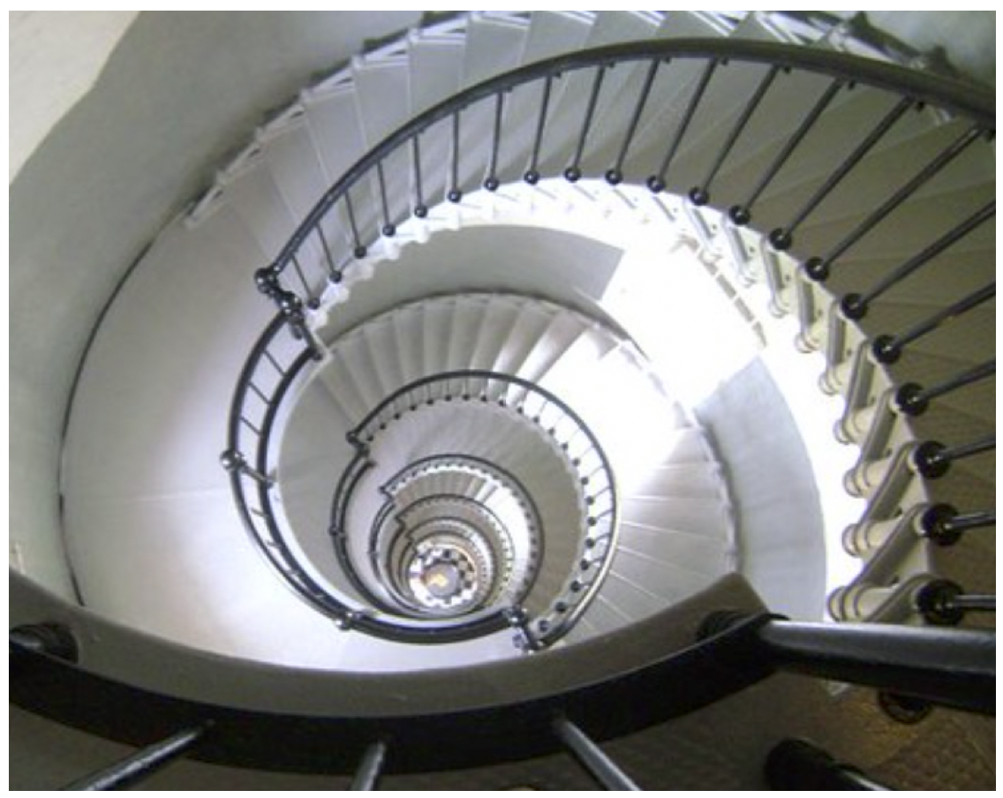
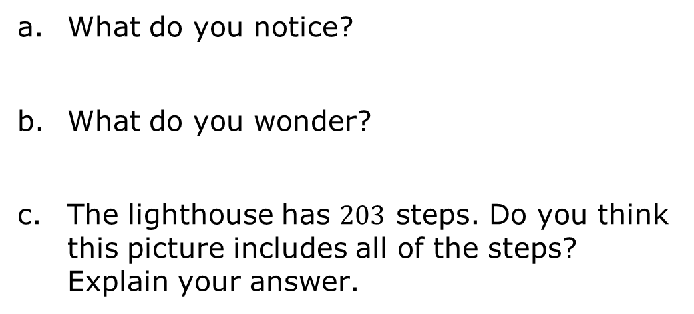
7.9.1 Warm-Up: Notice and Wonder
The picture shows the stairs in the Ponce de Leon Inlet Lighthouse.
What do you notice?
What do you wonder?
The lighthouse has $203$ steps. Do you think this picture includes all of the steps? Explain your answer.
volume 1, pg. 422

Slide 7

Collaboration
volume 1, pg. 422

Slide 8

7.9.2 Collaboration: Angle of Depression and Angle of Elevation
Real-world trigonometric ratio problems involve angles that are made from a horizontal line of sight.
Using a ruler, draw the horizontal line of sight for the man.
volume 1, pg. 422

Slide 9

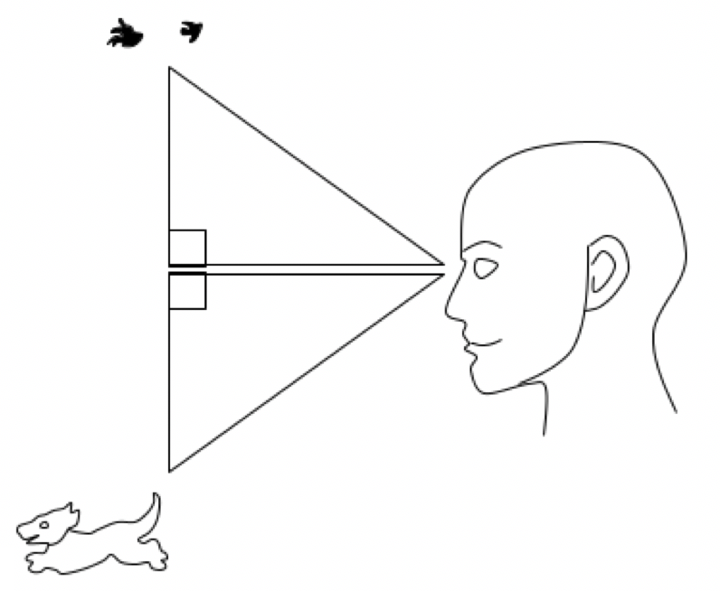
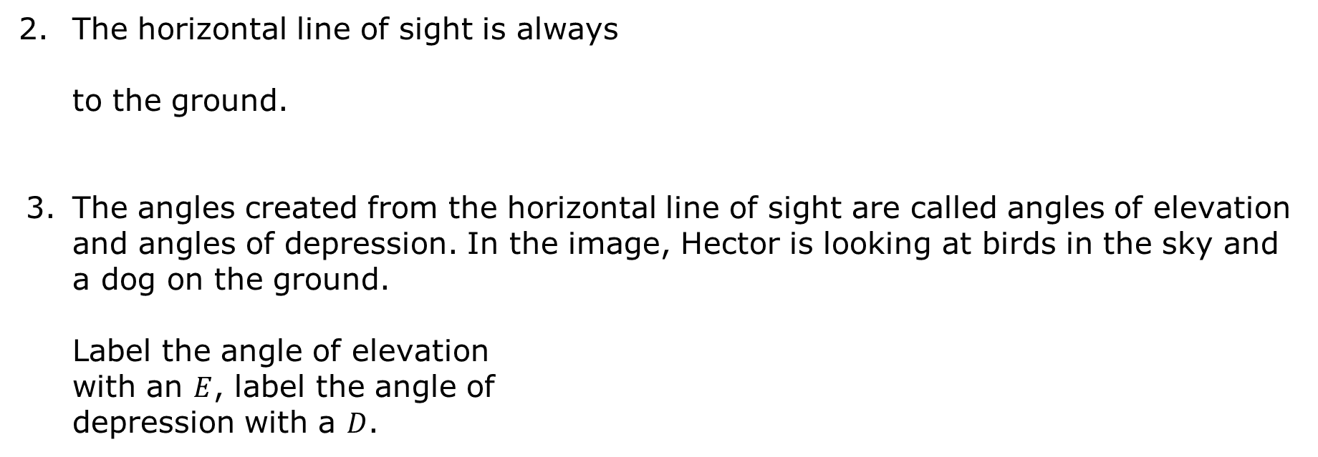
The horizontal line of sight is always
to the ground.
The angles created from the horizontal line of sight are called angles of elevation and angles of depression. In the image, Hector is looking at birds in the sky and a dog on the ground.
Label the angle of elevation
with an $E$, label the angle of
depression with a $D$.
volume 1, pg. 422

Slide 10
Based on the name of the angle, work with a partner to write a definition for an angle of elevation.
Work with a partner to write a definition for an angle of depression.
Compare your definitions with that of another pair. Discuss any differences. Make changes as necessary.
volume 1, pg. 423

Slide 11

Guided Instruction
volume 1, pg. 423

Slide 12

7.9.3 Guided Instruction: Angles of Elevation and Depression
The angle of elevation is the angle created above the horizontal when looking up at an object.
The angle of depression is the angle created below the horizontal when looking down at an object.
volume 1, pg. 423

Slide 13
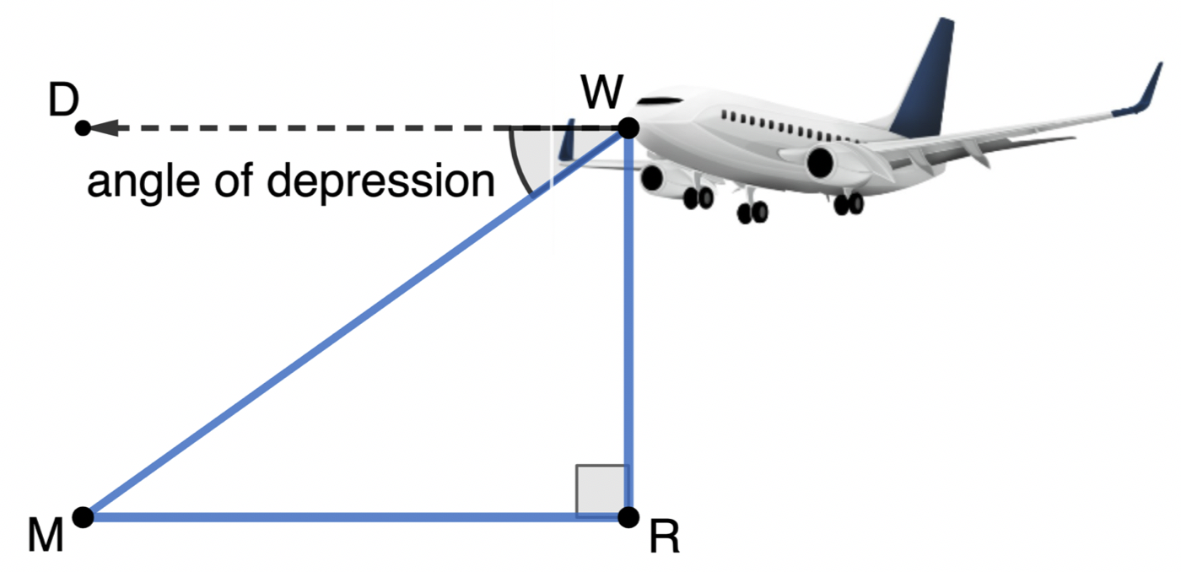

The angle of depression, $m∠DWM,$ from the airplane to the runway, point $M$, is $37°$.
Explain why $∠DWM$ is congruent to $∠RMW$.
volume 1, pg. 423

Slide 14
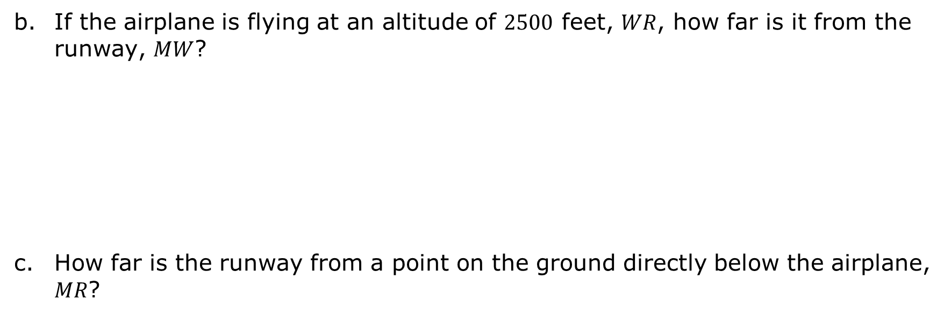
If the airplane is flying at an altitude of $2500$ feet, $WR$, how far is it from the runway, $MW$?
How far is the runway from a point on the ground directly below the airplane, $MR$?
volume 1, pg. 424

Slide 15
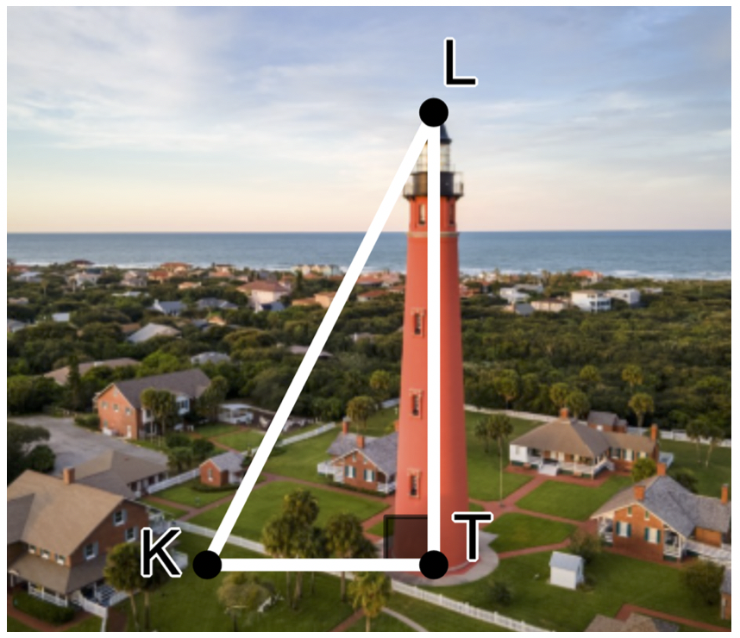

Kamala is visiting the Ponce de Leon Inlet Lighthouse. Kamala is standing at point $K$ and is looking at the top of the lighthouse, point $L$. $\overline{KT}$ is from Kamala’s eye level, which is at $1.75$ meters (m).
When Kamala looks at the top of the lighthouse, is the angle created an angle of elevation or depression?
volume 1, pg. 424

Slide 16
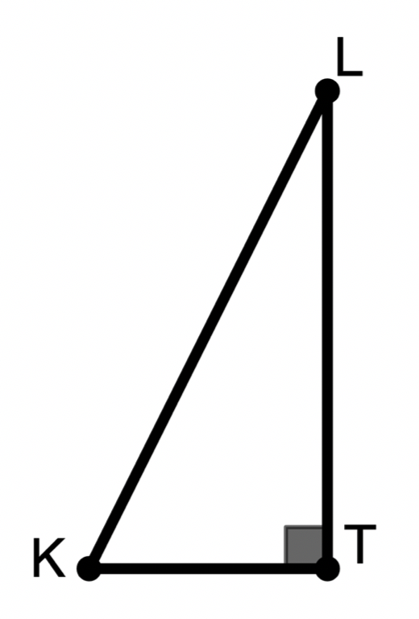

The height of the Ponce de Leon Inlet Lighthouse is $53$ m. Kamala is standing $15.25$ m from the lighthouse. Label $∆KTL$ appropriately with this information.
What is the measure of the angle created when Kamala looks at the top of the lighthouse?
volume 1, pg. 425

Slide 17

Guided Practice
volume 1, pg. 425

Slide 18
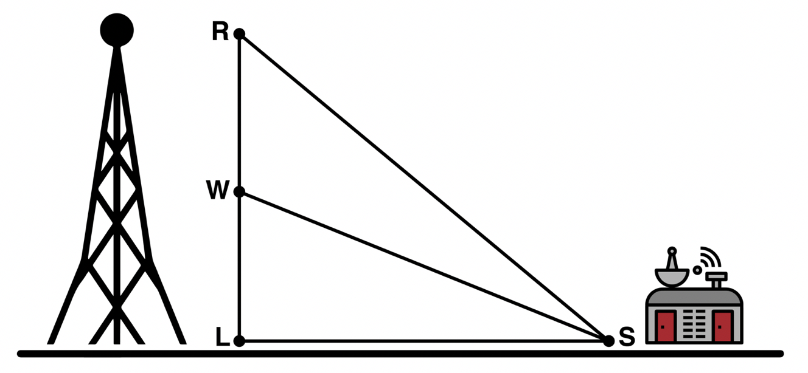
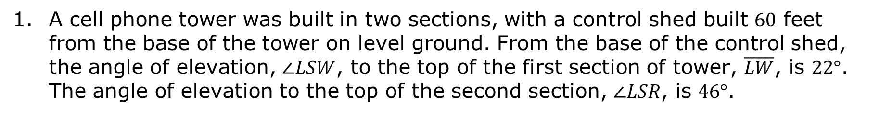
7.9.4 Guided Practice: Trigonometry in the Real World
A cell phone tower was built in two sections, with a control shed built $60$ feet from the base of the tower on level ground. From the base of the control shed, the angle of elevation, $∠LSW$, to the top of the first section of tower, $\overline{LW}$, is $22°$. The angle of elevation to the top of the second section, $∠LSR$, is $46°$.
volume 1, pg. 425

Slide 19
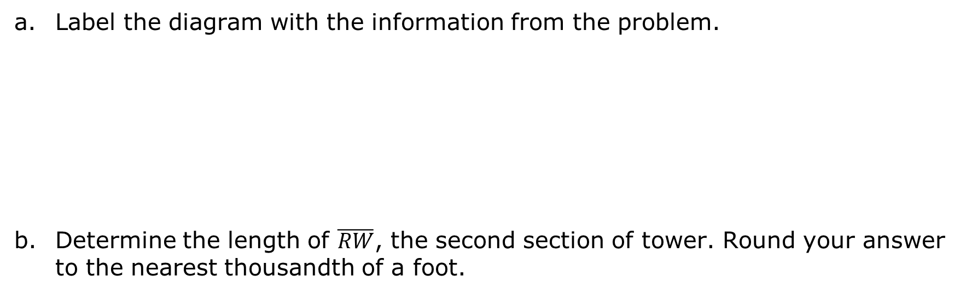
Label the diagram with the information from the problem.
Determine the length of $\overline{RW}$, the second section of tower. Round your answer to the nearest thousandth of a foot.
volume 1, pg. 425

Slide 20
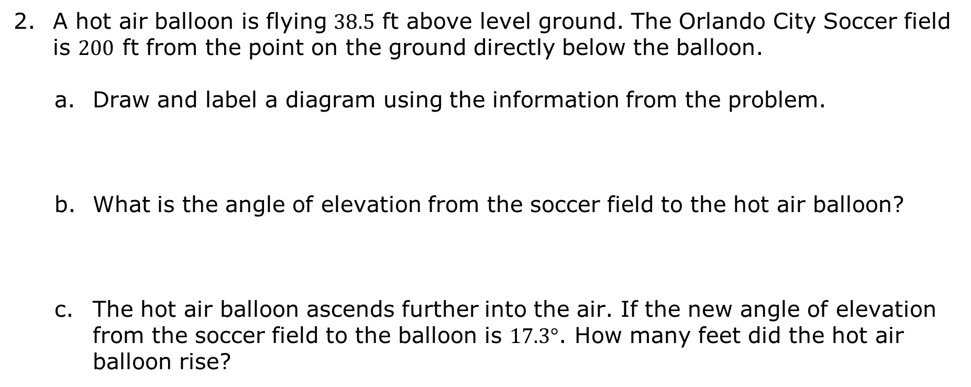
A hot air balloon is flying $38.5$ ft above level ground. The Orlando City Soccer field is $200$ ft from the point on the ground directly below the balloon.
Draw and label a diagram using the information from the problem.
What is the angle of elevation from the soccer field to the hot air balloon?
The hot air balloon ascends further into the air. If the new angle of elevation from the soccer field to the balloon is $17.3°$. How many feet did the hot air balloon rise?
volume 1, pg. 426

Slide 21

Your Turn
volume 1, pg. 426

Slide 22
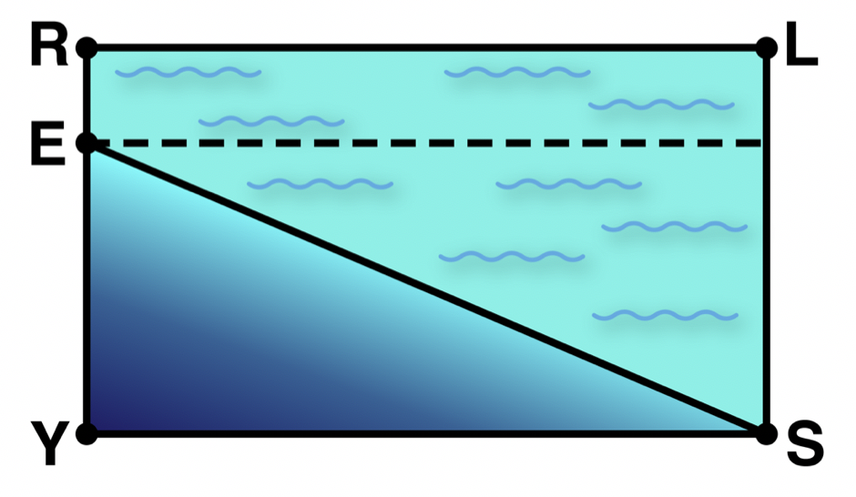
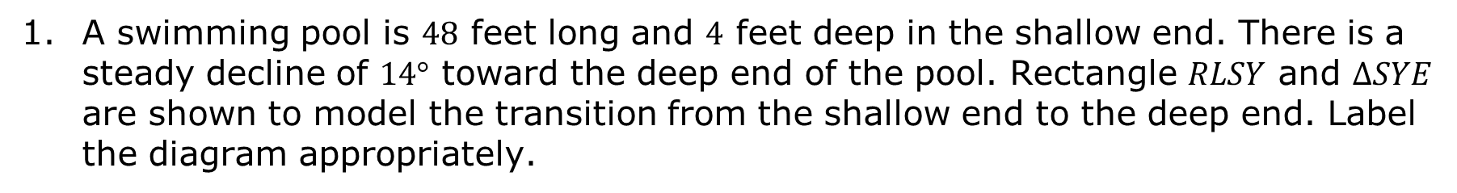
7.9.5 Your Turn!
A swimming pool is $48$ feet long and $4$ feet deep in the shallow end. There is a steady decline of $14°$ toward the deep end of the pool. Rectangle $RLSY$ and $∆SYE$ are shown to model the transition from the shallow end to the deep end. Label the diagram appropriately.
volume 1, pg. 426

Slide 23
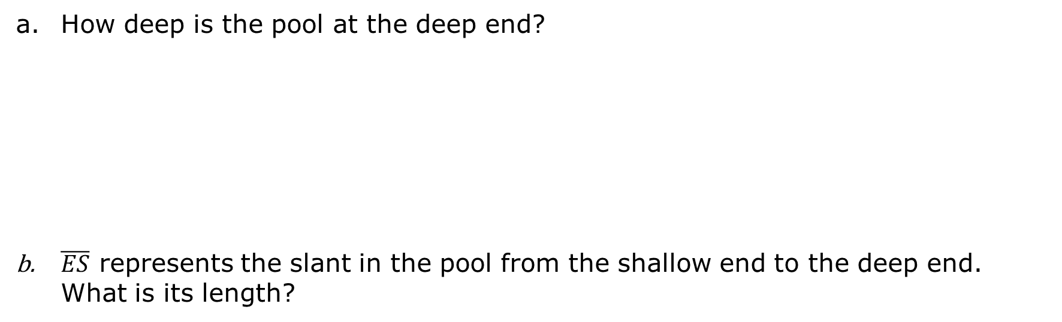
How deep is the pool at the deep end?
$\overline{ES}$ represents the slant in the pool from the shallow end to the deep end. What is its length?
volume 1, pg. 426

Slide 24

Wrap-Up
volume 1, pg. 427

Slide 25

7.9.6 Wrap-Up: Reflection
Circle the color on the stoplight that best represents your understanding of solving real-world problems using an angle of depression or an angle of elevation.
Red: I do not understand.
Yellow: I need some more help.
Green: I got this; I understand!
volume 1, pg. 427

Slide 26
Complete the following statements if you selected red or yellow.
I am still unsure about …
To fill in this gap I intend to …
volume 1, pg. 427

